Slide 1
Custom alert action in Splunk
Splunk App development (for version 8.X)

Slide 2
Agenda
Splunk APP architecture,
How to build Custom Alert Action APP,
Workflow automation using the APP,
Logic building with Python,
APP packaging,

Slide 3
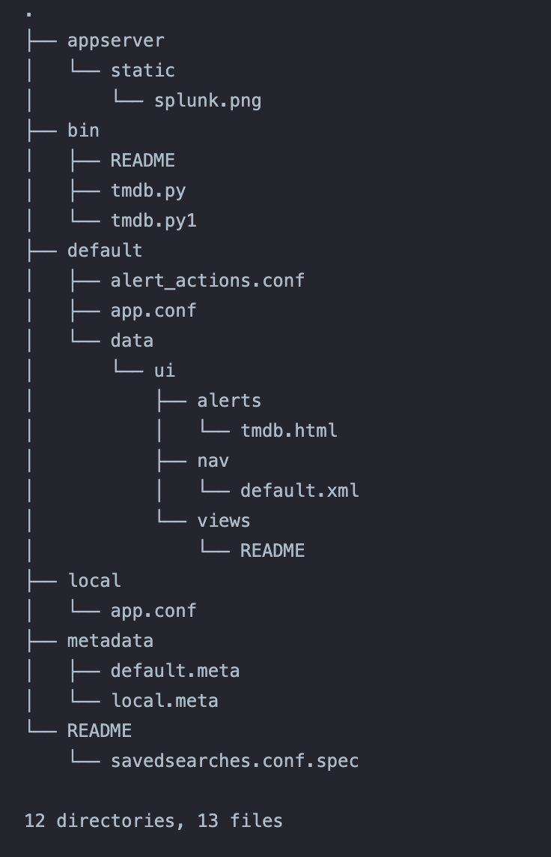
App Overview
Add-On's
APPS
Files / Folder structure
Custom Alert
Splunk APP ecosystem

Slide 4
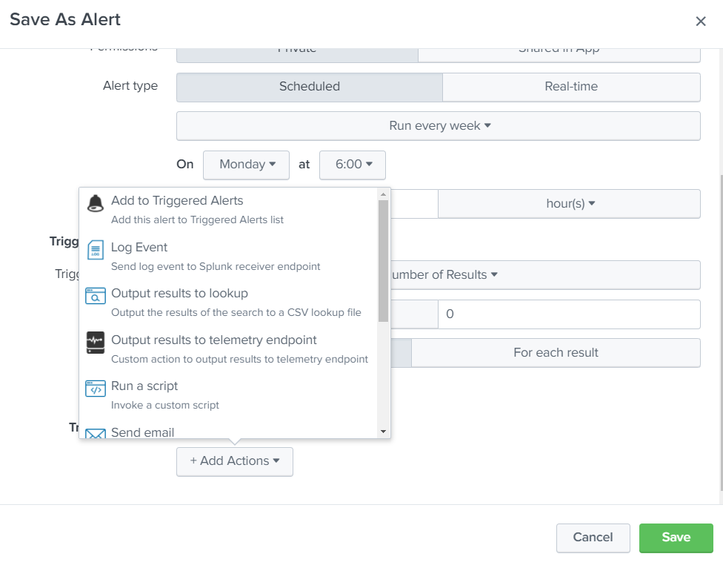
Custom Alert Action
“Custom alert action can be used to automate the workflow such as; enable/ disable user accounts, run a nmap scan on the target, raise a service ticket for the incidents, etc.”

Slide 5
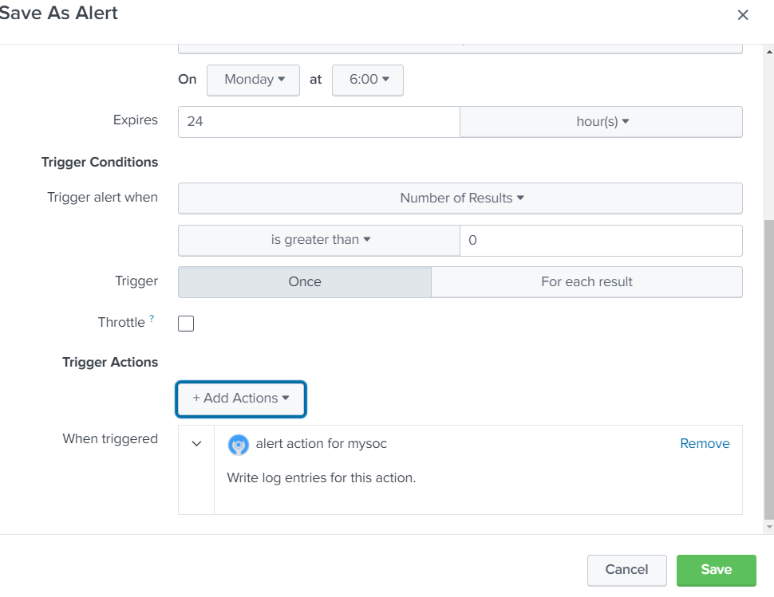
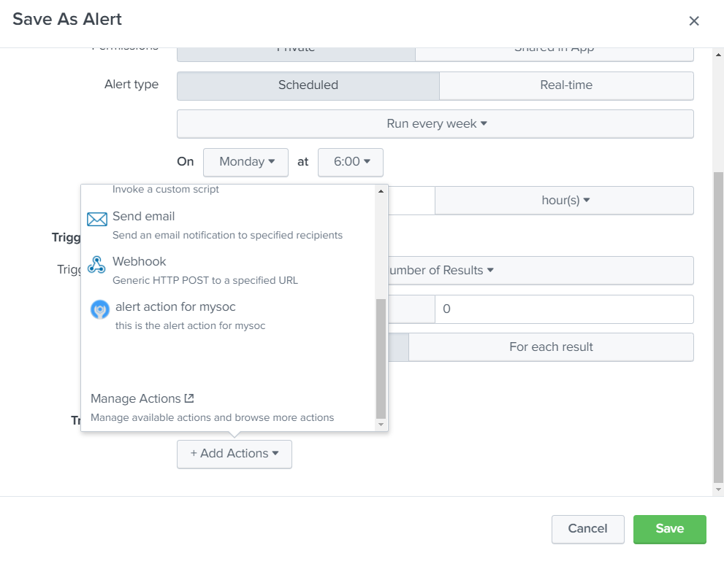
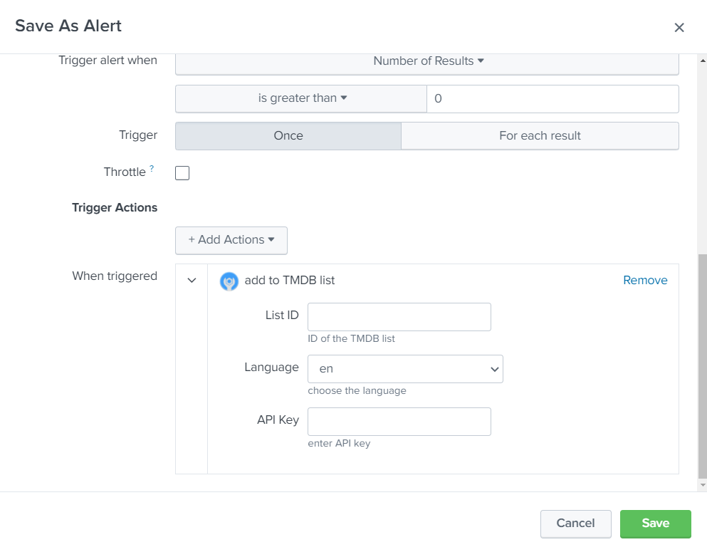
Workflow automation

Slide 6
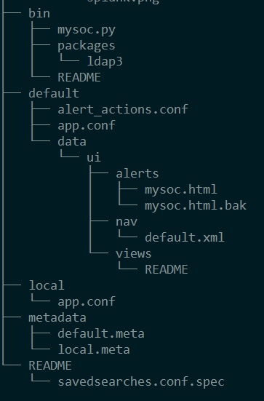
APP basic hierarchy
CONF files
UI files
Logic Files
*Nix platforms
filename.sh
filename.py
filename.js
filename (executable)
Windows platforms
filename.bat
filename.cmd
filename.py
filename.js
filename.exe
Supported files

Slide 7
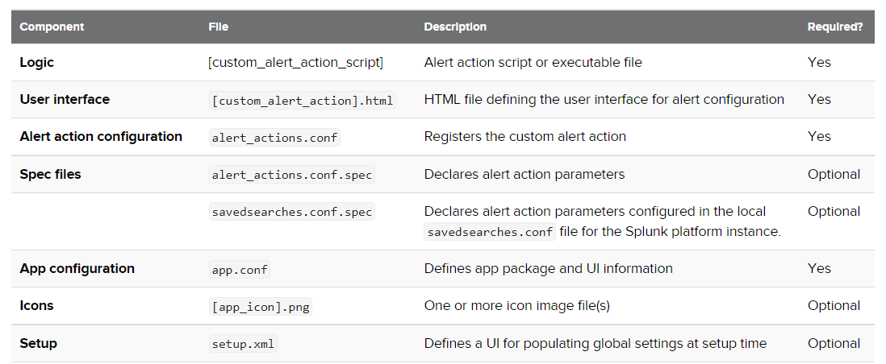
APP basic hierarchy

Slide 8
Approach : Python
Option 1: Using native/ 3rd party modules
Option 2: Using Splunk SDK
$SPLUNK_HOME$/etc/apps/[myapp]/bin/

Slide 9
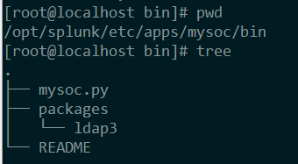
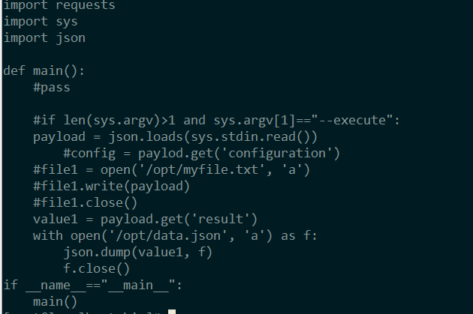
Python Coding
Alert logic is written in the script files
Place all the script files in the /bin directory,
The initial python script name (example; mysoc) must be used in other Splunk configuration files,
Configuration
Results
Payload

Slide 10
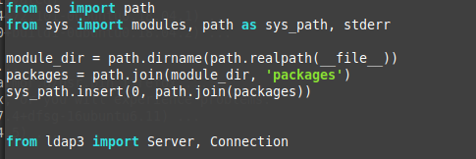
Python : handle dependencies
Instead of installing the python dependencies on the Splunk instance (python), we can download the module from GitHub and place it in the /bin or / lib directory.
Use the below logic to load the modules manually to the code
** the python file needs to converted to the .pyc to hide the credentials such as password/ API key/ etc.

Slide 11
LDAP automation
Custom alert action to disable/ enable AD users

Slide 12
< end of the document >
Jinto Antony

